Slide 1

Microsoft DevOps Hackathon
Vancouver
Dec 10/11
Notes:
Cover Option 1

Slide 2

Jef King | ‏@jefkingabc
Senior Technical Evangelist
https://channel9.msdn.com/Series/onacloud
Start-up founder & Advisor
Working in IT since 1999
Frequent speaker at conferences
http://github.com/jefking

Slide 3

Amir Ahani, M.A.Sc. & MBA | @Amir_Ahani
.NET Microsoft MVP
http://www.HumaSolutions.com
IT Director and President
Working in IT since 1995
Frequent speaker at conference
Instructor of Advanced .NET courses @ BCIT

Slide 4

Amadeus Wieczorek | ‏@HiAmadeus
Start-up founder
Software Engineer
http://github.com/AmadeusW

Slide 5

Erik Hougaard | ‏@eHougaard
E Foqus Canada Inc.
R&D Manager
www.hougaard.com

Slide 6
Agenda
DevOps overview
Enabling DevOps practices
Hackathon details
Notes:
Agenda

Slide 7
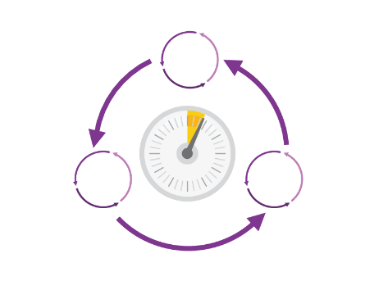
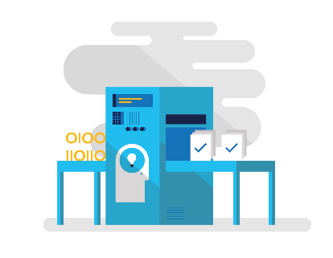
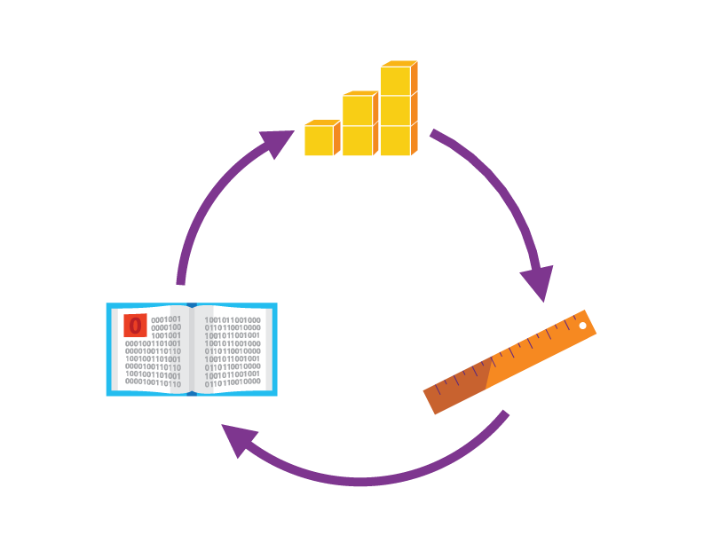

How the Hackathon will work?
# Teams mixing ITPros and Developers
Required: your app with Infra as Code + at least 1 other DevOps Practice
We challenge you to be creative and differentiate your team!
Your team will have 5 minutes to present your solution and be the winner (Day 2)!

Slide 8
DevOps overview
Notes:
Cover Option 2

Slide 9

“DevOps is development and operations collaboration”
“DevOps is treating your infrastructure as code”
It’s DevOps!
It’s DevOps!
“DevOps is using automation”
It’s DevOps!
“DevOps is feature switches”
It’s DevOps!
“DevOps is small deployments”
“Kanban for Ops?”

Slide 10
Speaker Notes
Pick at least 1 of the next 3 slides to state business challenges/need for DevOps
It’s Tough out there – How the market/customers are demanding more
Software Delivery Challenges – High-Level challenges for any org
The Consequences of inefficiency – data points on not doing DevOps
Please remove this slide before handout
Please remove this slide before handout
Please remove this slide before handout

Slide 11
Software delivery challenges
?
Frustration
Delays
Lack of insights
Notes:
But how is it that some companies like Netflix, Amazon, Etsy, and Facebook regularly deliver new features and innovation to their customers while other companies must wait weeks or months to release software updates?
Today, we see continual frustration on all sides:
Business, customers and IT all suffer from a lack of collaboration and communication between development and operations in software projects
This increases time and labor involved in delivering and maintaining software systems – not a good thing in a world where fast time to market is key
Add to that the problem that much of what we build is based on assumptions instead of hard data and you can see how this could easily lead a team to build the wrong thing
The inability to deliver software efficiently and react quickly to changes can lead to much more than just frustration –in the long run, this can threaten your entire business!

Slide 12






The consequences of inefficiency
40
%
… of implementations end up getting reworked because they don’t meet the users’ original requirements
IT drives business
success!
High IT performance correlates with strong business performance, helps boost productivity, market share and profit.
Outperforming teams are
collaborate
54
%
extensively
more likely to
41
%
… of development budgets for software, IT staff and external professional services will be consumed by poor requirements
with their
Collaboration blockers
counterparts
80
%
failure rate …
26.7% No executive support
56.7% Cultural inhibitors
43.3% Fragmented processes
… for companies that try to adapt their existing tools for DevOps practices
Developers
IT Ops
%
Business
70
o
f
CIOs
Would increase risk
1 in
6
It takes on average 200 minutes to diagnose and repair a production issue
IT decision makers is still unfamiliar with the term DevOps
to reduce IT costs
and accelerate business agility
3/4
of teams
DevOps was being initiated by more development teams than IT Ops teams by about a 40% to 33% margin
The average hourly cost of infrastructure failure is $100,000 per hour
A bug caught in production ends up costing
than if the same bug was found earlier in the development cycle
Responding to ongoing needs for efficiency and growth
100x more
have adopted
Agile methodologies
dual goals
Always keeping all systems safe and secure
Notes:
In the real world, there are real consequences if you are unable to deliver high-quality software quickly or build the wrong thing to begin with:
40% of implementations end up getting reworked because they don’t meet the users’ original requirements
The average cost of one hour downtime of a customer-facing app is calculated at 100.000 dollars per hour – and this does not take into account the damage to reputation, which can be even greater. Fixing such production issues takes on average 200 minutes per incident
Three quarters of development teams have adopted Agile methodologies today, enabling them to develop faster. While this is a great number, it does not help if a development team is Agile but deployment still takes weeks or months because IT Ops is perceived as not being Agile
These are just 3 very high-level examples but all the data we have today points toward the same conclusion – this is about more than just frustration or minor delays. Lack of collaboration between dev and ops can have substantial impact on a company’s bottom line and success

Slide 13
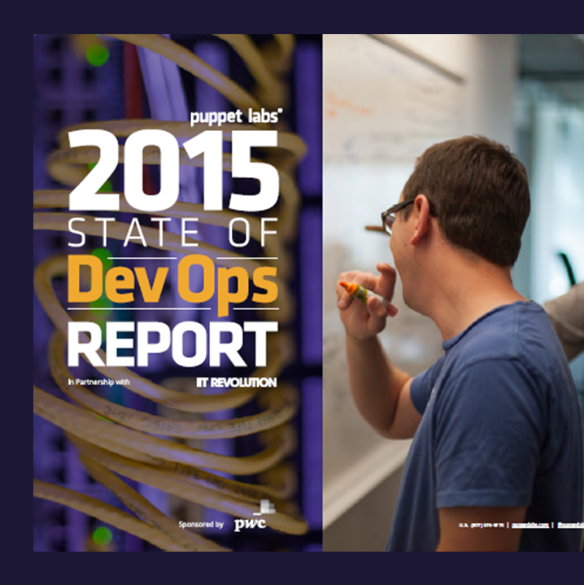
DevOps Benefits
Strong IT Performance is a competitive advantage
Deploy code 30x faster
Firms with high-performing IT organizations were 2x as likely to exceed their profitability, market share, and productivity goals
and with 200x shorter lead time as compared to their lower-performing peers
Have 60x fewer failures
DevOps Practices improve IT performance
and recover from failure 168x faster as compared to their lower-performing peers
Source: https://puppetlabs.com/
Notes:
2014 Report collected in December 2013 had over 9,200 survey respondents across 110 countries with companies of ALL sizes and verticals.
2015 Report had 4,976 respondents with companies of ALL sizes and verticals.

Slide 14






DevOps: the three stage conversation
DEV
OPS
1
People
2
Process
3
Products
Notes:
People = Culture
Fundamental attributes of successful cultures:
Shared mission and incentives: infrastructure as code, apps as services, DevOps/all as teams
You need to consider your hardware as a commodity, (don't give your servers names) , servers are like farm animals, it is just harder if you let theids name them
Build deep instrumentation into services, push complexity up the stack
Rally around agile, shared metrics, CI, service owners on call, etc.
Changing the culture: any change takes time, changing culture is no exception and you can't do it alone, exploit compelling events to change culture: downtimes, cloud adoption, devops buzz
PROCESS Definition and design, compliance, and continuous improvement
PEOPLE Responsibilities, management, skills development, and discipline
Products Tools and infrastructure

Slide 15
DevOps Maturity Assessment
Backlog
How an organization defines and manages requirements and how effective they are.
Flow
The flow of value as code moves through the system from developer environment to production, and the rate at which business value is delivered in the form of software.
Technical Debt
Behaviors and characteristics that define how an organization thinks about the decisions they make that incur technical debt as well as how they discover and manage technical debt that is accrued throughout the application lifecycle.
Agile Schedule and Teams
Behaviors and characteristics that reflect team organization and work schedule.
Flow of Value
Hypothesis- driven Backlog
Evidence
Characteristics and behaviors that demonstrate how an organization uses data in decision making, including code analysis, test results and real-world usage metrics.
Production
Refers to how an organization manages software in its production environment, including how it detects and responds to unexpected events.
Cloud Infrastructure
Refers to the behaviors and characteristics of how the organization approaches and manages the core infrastructure that their systems and apps run on.
Evidence and Data
Technical Debt
Production-first Mindset
DevOps
Agile Schedule and Teams
Public and Hybrid Cloud
http://devopsassessment.azurewebsites.net/
Notes:
DevOps is an umbrella term for a number of process categories that define an organization’s ability to deliver value.
The seven practices on this slide can be addressed either individually or together, in any combination.
Establishing and evolving any of the practices in your development lifecycle will positively impact your organization.
Backlog - How do you currently manage requirements and change requests? How are software requirements associated to business needs/value?
Schedule and team - How are your teams organized? Does every discipline report to the same executive? What is the typical team size and makeup (i.e. what disciplines are in a team)? How do these teams schedule their work? How long is a development iteration? How do development teams and IT Operations teams collaborate?
Technical debt - How do your teams think about and manage technical debt? What is the split in time spent on servicing existing code vs. new development activities and innovation? How do your teams ensure a common definition of done? How much of your resources are invested in engineering systems?
Flow - How does software flow through your delivery pipeline from build to production? How long does it take to provision a new dev/test environment? How frequently do you release per application? What is your release process?
Evidence - How are decisions made in software development? What data do you collect and use in decision making? How frequently do you use tools to validate software (code analysis, unit tests, functional tests, etc.)? How closely do your test environments mimic production? How do you use measure and react to how users interact with your software?
Production - How do you detect and respond to production incidents? What is your Mean-Time-To-Detection (MTTD)? What is your Mean-Time-To-Recovery (MTTR)?
Infrastructure - Describe the core infrastructure your applications run on? Are your dev/test environments hosted on-premises or in a public cloud? Are your production environments hosted on-premises or in a public cloud? Is your core infrastructure provided as a service either internally or by a third-party?

Slide 16
DevOps Frame
200 level Practices
300 level Product w/ Practice
100 level Overview
Azure Deployment Template with Azure Website + SQL DB
Infrastructure as Code
Chef Recipe with Linux VM on Azure
People, Process, Biz Value, LM foundation, etc.
Visual Studio Online (git) + Jenkins (build)
Continuous Integration
Github + Visual Studio Online + Gradle
Notes:
This is the framework for which you could connect the 300 level technology demos back to DevOps for any of your presentations. Do not present this slide to customers.
Sample DevOps practices might include:
Continuous Integration
Infrastructure/Configuration as code
Self Service Environments
Continuous Deployment
Test automation
Release Management
Performance Monitoring
Alerting
Production Diagnostics
Availability Monitoring
Feature Flags
Automated Environment De-Provisioning
Automated Recovery (Rollback & Roll-Forward)
Hypothesis Driven Development
TiP
Fault Injection
Usage Monitoring / User Telemetry
Load Testing

Slide 17
List of DevOps Practices
Infrastructure as Code (IaC)
Continuous Integration
Automated Testing
Continuous Deployment
Release Management
App Performance Monitoring
Load Testing & Auto-Scale
Availability Monitoring
Change/Configuration Management
Feature Flags
Automated Environment De-Provisioning
Self Service Environments
Automated Recovery (Rollback & Roll-Forward)
Hypothesis Driven Development
Testing in Production
Fault Injection
Usage Monitoring/User Telemetry
http://www.itproguy.com/devops-practices/

Slide 18



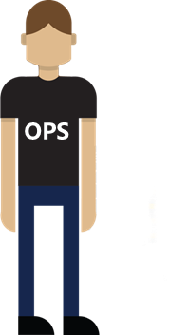








Microsoft Ecosystem
Test
Deploy
Environments
Monitor and Learn
MICROSOFT AZURE
Team Foundation Server
Microsoft Test Manager
Microsoft Monitoring Agent
ONE CONSISTENT PLATFORM
Release Management for Visual Studio
ON-PREMISES
SERVICE PROVIDER
Visual Studio Online Application Insights
Production / Stage
Automation Service
Developer Workstations
Develop
Build
PowerShell
MAML
Source
Team Foundation Server
xPlat CLI
Release Management for Visual Studio
Azure Resource Management
Team Foundation Server
Dev/Test
Processes
Release Management for Visual Studio
Team Foundation Server

Slide 19

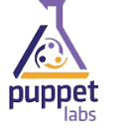











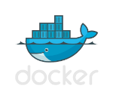


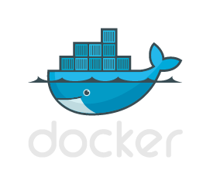

Heterogeneous Ecosystem
Test
Deploy
Environments
Monitor and Learn
MICROSOFT AZURE
Puppet Labs
ONE CONSISTENT PLATFORM
Chef
ON-PREMISES
SERVICE PROVIDER
Production / Stage
Hudson
Zabbix
Developer Workstations
Develop
Build
Saltstack
Source
Vagrant
GitHub
Codeplex
Grunt
Gradle
Vagrant
Dev / Test
Processes
Notes:
Microsoft also invests heavily in the open source ecosystem and enables you to keep your existing investments in open source tools while potentially enabling integration with our own technologies. In fact, we have an entire organization called MS OpenTech who are dedicated to this pursuit.
In this slide you can see a number of different open source products we have interoperability with which play different roles across the entire application lifecycle. These open source tools often play a part in more than one aspect of the product lifecycle, but they are listed here based on the primary integration point with a Microsoft technology.
Last but not least, I’d like to point out that the Microsoft Cloud OS platform where you might decide to host your application supports various programming languages like node.js, php, and java as well as underlying open source operating systems like Linux.
http://msopentech.com/blog/project-categories/devops/

Slide 20
Team Foundation Server & Visual Studio Online
Source control
Agile planning
Test case management
Build automation
Continuous deployment
Release management
Load testing
Feedback management
Team collaboration
Application telemetry
Lab management
Notes:
Features in Visual Studio Online get released once every three weeks and around once per quarter those features get rolled up and put into an update which goes into the on-premises Team Foundation Server. So no matter whether you prefer to do your business in the cloud, hybrid, or on-premises, Microsoft has you covered.

Slide 21
Power of Azure with the control of the datacenter Introducing the Microsoft Azure Stack
App Innovation
Windows Server
Linux
Windows Server
Linux
Hybrid
Hyper-scale
Enterprise-grade
Portal
IaaS | PaaS services
Portal
IaaS | PaaS services
Cloud-inspired infrastructure
Powered by Windows Server, Hyper-V, System Center, and Azure technologies
Cloud infrastructure
Microsoft Azure Stack
Datacenter
Microsoft Azure
Notes:
Microsoft Azure Stack gives your organization the ability to do anything you can do in the public cloud via the new Azure Resource Manager API at portal.azure.com, on-premises in your own datacenter. So no matter whether you prefer to do your business in the cloud, hybrid, or on-premises, Microsoft has you covered.
https://channel9.msdn.com/Events/Ignite/2015/BRK2484

Slide 22
Enabling DevOps Practices
Notes:
Cover Option 2

Slide 23
DevOps
1
4
Plan
Monitor + Learn
Development
Production
2
3
Develop + Test
Release

Slide 24
Plan
It starts with an idea – and a plan how to turn this idea into reality…
Project starts
Manage work
Develop + Test
1
Track progress
Plan

Slide 25
Kanban with Visual Studio Online

Slide 26
Develop + Test
Once the iteration starts, developers turn great ideas into features…
2
Write Code
Unit Testing
Version Control
Build
Build Verification
Release

Slide 27



Continuous Integration
Source
Build
Value
Accelerate Delivery
Repeatability
Optimized Resources
Test
Measure
Deployment Lead Time
MTTR
MTTD
DEV
OPS

Slide 28
Automated Testing
Testing Software
Value
Accelerate Delivery
Repeatability
Optimized Resources
X
Measure
Deployment Lead Time
MTTR
MTTD
DEV
OPS

Slide 29
Continuous Integration with Visual Studio Online

Slide 30
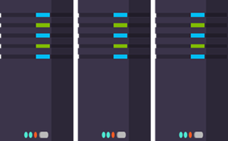
Release
When all tests pass, the build is deployed to testing environments for each stage in the release process
Cloud Load Testing
Integration testing
environment
Staging
environment
3
Monitor + Learn
Automated functional testing environment
Pre-production environment

Slide 31

Continuous Deployment
SOURCE & BUILD
QA ENVIRONMENT
Value
Optimized Resources
Accelerate Delivery
Measure
Deployment Frequency
MTTR
Availability
DEV
OPS
Notes:
Release Management in the Visual Studio Online Service (or on-prem product which not easy to access for hackathon)
Deployment Slots + CI/CD solution with VSO + Azure Websites

Slide 32
Release Management
SOURCE REPO
DEV
Value
Optimized Resources
Accelerate Delivery
STAGE
Measure
Deployment Frequency
MTTR
Availability
PRODUCTION
DEV
OPS
Notes:
David Note: Make sure to highlight customer pain points, “bullet train”, Poll??

Slide 33
Continuous Deployment and Release Management with Visual Studio Online

Slide 34
Infrastructure as Code
DEV
Value
Optimized Resources
Accelerate Delivery
CODE
STAGE
Measure
Deployment Rate
MTTR
OPS
PRODUCTION
DEV
OPS

Slide 35
Architecture Decisions
Azure VMs (IaaS)
Containers
Azure Cloud Services
(PaaS)
Azure Websites (PaaS)
Most control, but most management overhead
Most cost
Puppet/Chef/DSC agent integration
Easier to port workloads from on-premises
Easiest portability from on-premises
Ecosystem of apps
Host OS abstracted, but still requires management
Startup tasks
More complex workloads
Do more than websites
APM compatible
Easy CI and CD setup
Easy Auto Recovery
Easy Testing in Prod
Easy deployments and scale
Efficient Cost
Only websites

Slide 36
Azure Programmatic Interfaces
√ = Current
√ = Resource Manager
SERVICES | POWERSHELL | XPLAT-CLI | MAML | REST | Chef, Puppet, Vagrant
Virtual Machine | √ | √ | √ | √ √ | C P V
Cloud Service | √ |  | √ | √ | C P V
Website | √ | √ | √ √ | √ √
Network | √ | √ | √ | √ √ | C P
Storage | √ | √ | √ √ | √ √ | C P V
SQL Database | √ | √ | √ √ | √ √ | P
Service Bus | √ | √ | √ | √
Resource Groups | √ | √ |  | √
Scheduler | √ |  | √ | √ √
Monitoring |  |  | √ | √ √
Search |  |  | √ | √ √
HDInsight | √ | √ |  | √
Mobile Services |  | √ |  | √
Azure AD | √ √ |  | √ | √
Not a complete list
Notes:
PowerShell & xPlat-CLI – http://azure.microsoft.com/en-us/documentation/articles/install-configure-powershell/
MAML – https://www.nuget.org/packages?q=Microsoft.WindowsAzure.Management&prerelease=true&sortOrder=relevance
Resource Groups -
Chef - http://channel9.msdn.com/Shows/Edge/Edge-Show-93-Chef-deployments-to-Windows-Azure
Puppet - http://blogs.msdn.com/b/interoperability/archive/2013/12/12/windows-azure-provisioning-of-linux-and-windows-via-puppet.aspx
Vagrant - https://github.com/MSOpenTech/vagrant-azure

Slide 37
Infrastructure as Code with Azure Resource Manager Deployment Templates

Slide 38

Load Testing and Auto Scale
Application Environment
Value
Improve deployment quality
Find performance bottlenecks
Cater for demand
Maintain application quality
X
Measure
Availability
MTTD
MTTR
DEV
OPS
Auto Scale

Slide 39
Cloud Based Load Testing + Autoscale policies in IaC

Slide 40
Monitor + Learn
Learn and understand how users use your app, how it reacts and quickly fix issues and bugs
Plan the next iteration
Feedback
Monitor
4

Slide 41

Availability Monitoring
MONITORING
SERVICE
Value
Faster Detection & Remediation
PRODUCTION
Measure
MTTD
MTTR
Availability

Slide 42
Application Performance Monitoring
Value
Faster Detection & Remediation
Optimized Resources
More Resilience
MONITORING
SERVICE
PRODUCTION
Measure
MTTD
MTTR
Availability

Slide 43

Automated Recovery
Rollback
Value
Minimal/No business impact
Minimal/No manual intervention
SOURCE REPO
PRODUCTION
V2.0
X
V1.0
Measure
MTTR
Availability
X
V2.0

Slide 44
Automated Recovery
Roll-forward
Value
Minimal/No business impact
Minimal/No manual intervention
SOURCE REPO
PRODUCTION
V2.1
V2.0
X
Measure
MTTR
Availability
X
V2.1
Notes:
Roll-forward means making a fix to the code
Check-in fix, quickly test, “roll-forward” by pushing a new release

Slide 45
Automated Monitoring Parts Unlimited App

Slide 46
Configuration Management
Value
Faster Detection & Remediation
Optimized Resources
More Resilience
MANAGEMENT
SERVICE
PRODUCTION
Measure
MTTD
MTTR
Availability

Slide 47
Automated environment de-provisioning
Value
Optimized Resources
Inexpensive provisioning
Rapid response
IIS
SQL
APP
Client
Measure
Lower TCO
Automation
Notes:
Why not deprovision CI, after test cases are run?

Slide 48
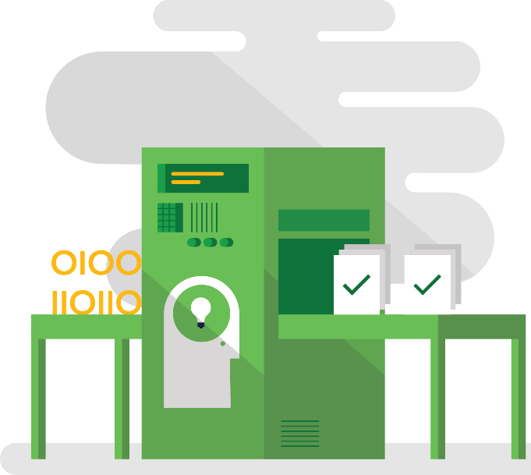


Hypothesis Driven Development
Testing in Production
Telemetry
Fault Injection
PRODUCTION A
PRODUCTION B
PRODUCTION
X
X
X
90%
10%
X

Slide 49
Testing in Production
Value
Experimentation
More Resilience
Accelerate Delivery
PRODUCTION A
90%
Measure
Deployment Rate
MTTR
Availability
Change Lead Time
PRODUCTION B
10%

Slide 50
User Telemetry
SOURCE REPO
TELEMETRY SERVICE
Value
User engagement
Focus future app investment
Measure
User activity
….
PRODUCTION

Slide 51
Fault Injection
Alert
Value
App Resiliance
Faster Detection & Remediation
INFO
PRODUCTION
X
X
Measure
MTTR
Availability
Logs

Slide 52
Hackathon details
Notes:
Cover Option 2

Slide 53
How the Hackathon will work?
# Teams mixing ITPros and Developers
Required: Your App with Infra as Code + at least 1 other DevOps Practice
We challenge you to be creative and differentiate your Team!
Your team will have 5 minutes to present your solution and be the winner (Day 2)!

Slide 54
How will your team be Evaluated?
How creative was the solution?
Did you create something entirely new like a self-service website to deploy dev environments? (i.e. Azure Websites + Azure Automation + Deployment templates)
Did you create anything which could be re-used by the general public? i.e. Azure RM template to public Github
What DevOps Practices have you implemented?

Slide 55
Let’s form our teams!
On the whiteboard at the front of the class <or other solution> write:
Your first name
Rough idea you’d like to work on over the next two days
Examples:
Bob - New Azure RM deployment template for Windows Server Containers cluster with Docker
Sarah - Linux VM with Java app which cures world hunger

Slide 56
Start Hacking: Account Information
Azure Pass Account (one per team)
Visual Studio Online account (one per team)
Only one app/IaC per team is all that’s needed
Development/Working Machine
You can use your own and/or a VS 2015 VM from the Azure Gallery
Note: Azure SDK and Azure PowerShell can install via Web Platform installer.
This Deck (with all the DevOps Practices)
<speaker-insert-your-url>

Slide 57
Sample Applications
Fabrikam Fiber
https://github.com/dtzar/FabrikamFiber
Azure Website + SQL Azure DB
Parts Unlimited
https://github.com/Microsoft/PartsUnlimited
Azure Website + SQL Azure DB (with lots of advanced features enabled in the deployment template themselves)
Parts Unlimited MRP
https://github.com/Microsoft/PartsUnlimitedMRP
Linux, Java, Tomcat, MongoDB application with Chef Recipe

Slide 58
Free Resources for DevOps Practices
Accelerate your application delivery lifecycle
Optimize your DevOps practices and tools:
Get started on your DevOps journey: aka.ms/devops
Download the Forrester Infrastructure-as-Code whitepaper:
Complexity kills. Automate with Infra as code: aka.ms/iac_tlp
Technical resources for Practitioners:
Get access to free online training: aka.ms/devopsmva
DevOps Maturity Self-Assessment
See where your organization is at across 7 areas: http://devopsassessment.azurewebsites.net/
Learn DevOps Practices hands-on with PartsUnlimited apps
github.com/Microsoft/PartsUnlimited and github.com/Microsoft/PartsUnlimitedMRP

Slide 59

© 2015 Microsoft Corporation. All rights reserved. Microsoft, Windows and other product names are or may be registered trademarks and/or trademarks in the U.S. and/or other countries.
The information herein is for informational purposes only and represents the current view of Microsoft Corporation as of the date of this presentation. Because Microsoft must respond to changing market conditions, it should not be interpreted to be a commitment on the part of Microsoft, and Microsoft cannot guarantee the accuracy of any information provided after the date of this presentation. MICROSOFT MAKES NO WARRANTIES, EXPRESS, IMPLIED OR STATUTORY, AS TO THE INFORMATION IN THIS PRESENTATION.

Slide 60

The first way (systems thinking)
DEV
OPS
Notes:
The First Way emphasizes the performance of the entire system, as opposed to the performance of a specific silo of work or department - this can be as large as a division (e.g., Development or IT Operations) or as small as an individual contributor (e.g., a developer, system administrator).
It begins when requirements are identified (e.g., by the business or IT), are built in Development, and then transitioned into IT Operations, where the value is delivered to the customer.
When we think as a system, we can focus clearly on the business value that flows between business, dev, ops, and end users.
The outcomes of putting the First Way into practice include never passing a known defect to downstream work centers, never allowing local optimization to create global degradation, always seeking to increase flow, and always seeking to achieve profound understanding of the whole system.
For more information on the Three Ways, check out:
http://itrevolution.com/a-personal-reinterpretation-of-the-three-ways/

Slide 61

The second way (feedback loops)
DEV
OPS
Notes:
The Second Way is about creating right to left feedback loops.
The goal of almost any process improvement initiative is to shorten feedback loops so necessary corrections can be made quickly and continuously.
The outcomes of the Second Way include understanding and responding to all customers, internal and external, shortening and amplifying all feedback loops, and embedding knowledge where we need it.

Slide 62

The third way (experimentation)
DEV
OPS
Notes:
The Third Way is about creating a culture that fosters two things: continual experimentation, taking risks and learning from failure; and understanding that repetition and practice is the prerequisite to mastery.
Experimentation and taking risks are what ensures that we keep pushing to improve, even if it means going deeper into the danger zone than we’ve ever gone.
And we need mastery of the skills that can help us retreat out of the danger zone when we’ve gone too far.
The outcomes of the Third Way include allocating time for the improvement of daily work, creating rituals that reward the team for taking risks, and introducing faults into the system to increase resilience.

Slide 63
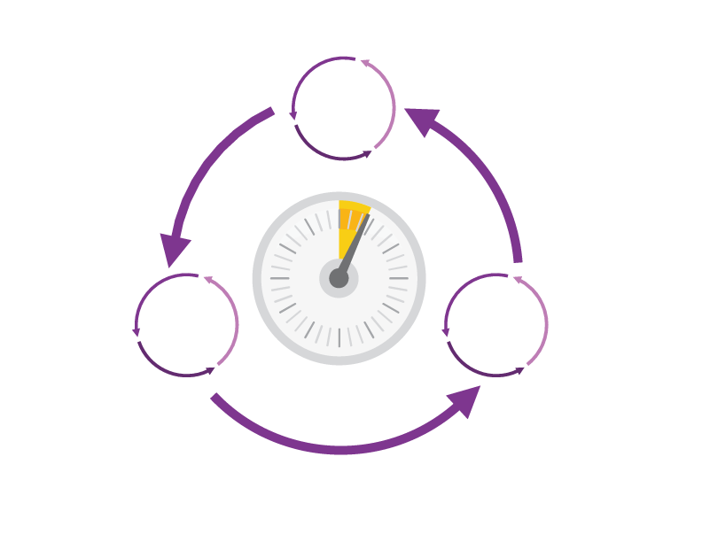
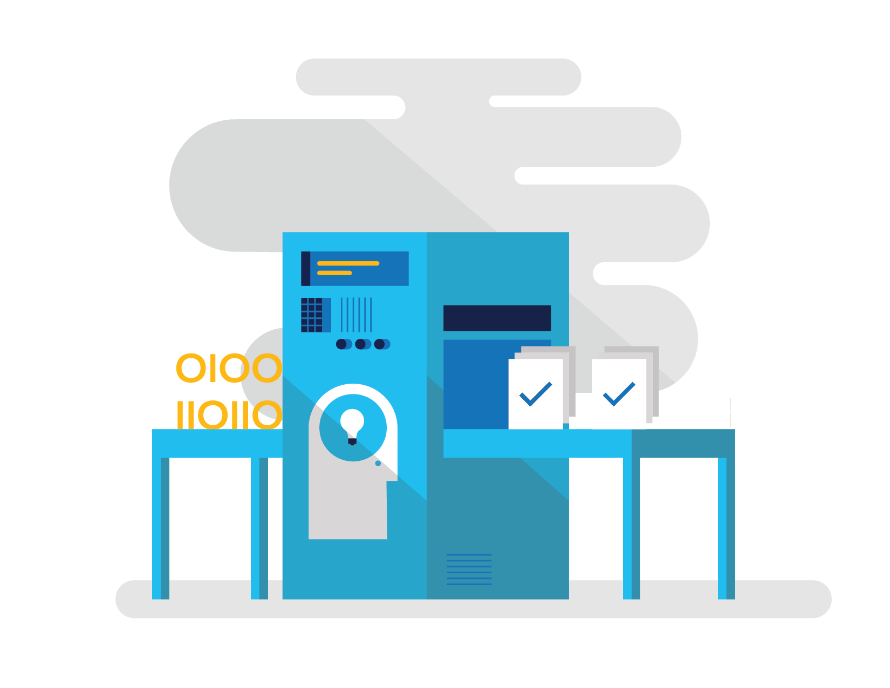
How DevOps can help
Shorten Cycle Times
Optimize Resources
Improve Quality and Availablilty
Speed up and increase traceability of each release by empowering your development and operations teams with advanced collaboration and automation tools.
Efficiently manage environments using technologies that support self-service provisioning in a secure way, in line with your IT governance standards.
Capture rich telemetry on application performance and usage so that you can make better decisions on future investments and anticipate issues in production before they impact your service.
Notes:
Shortening cycle times through advanced release management and automation tools
Optimizing resources and eliminating waste, and
Increasing quality and availability of your solutions

Slide 64
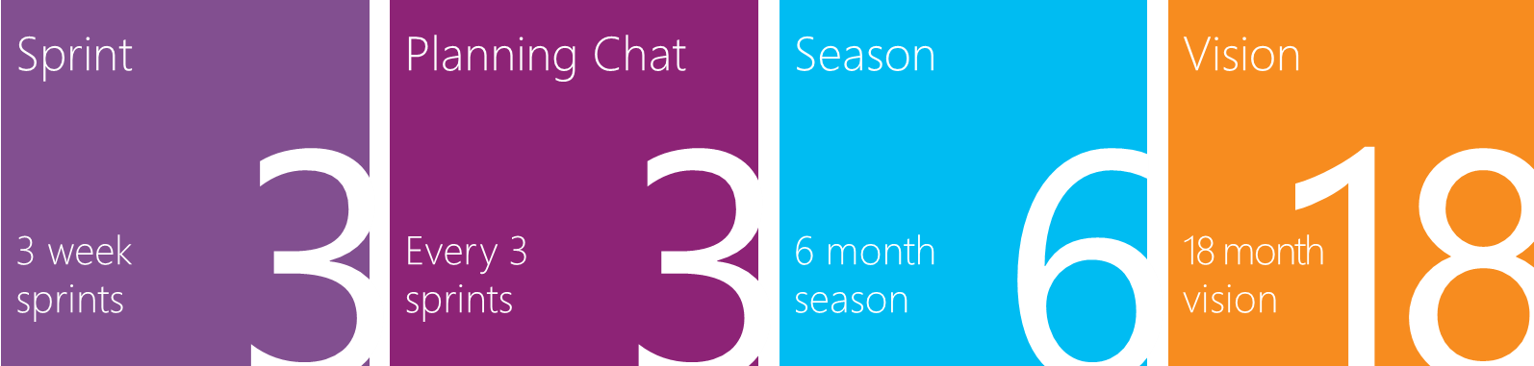
How Microsoft Does DevOps
Visual Studio Online Team
Build>Deploy>Test reliably, hundreds of times a day
We continue to meet a rigorous on-premises quality bar
We build confidence through staging, exposure control & rich telemetry
We are one team – close collaboration between Dev and Ops is key
Visit http://stories.visualstudio.com to get the full story!
Notes:
Today, we work very differently and we strive to deliver innovation quickly, without sacrificing quality
It was a fun journey and we are still learning – but now, we see positive results every day
For us, the key to success is the close collaboration between development and operations disciplines - we are one team

Slide 65
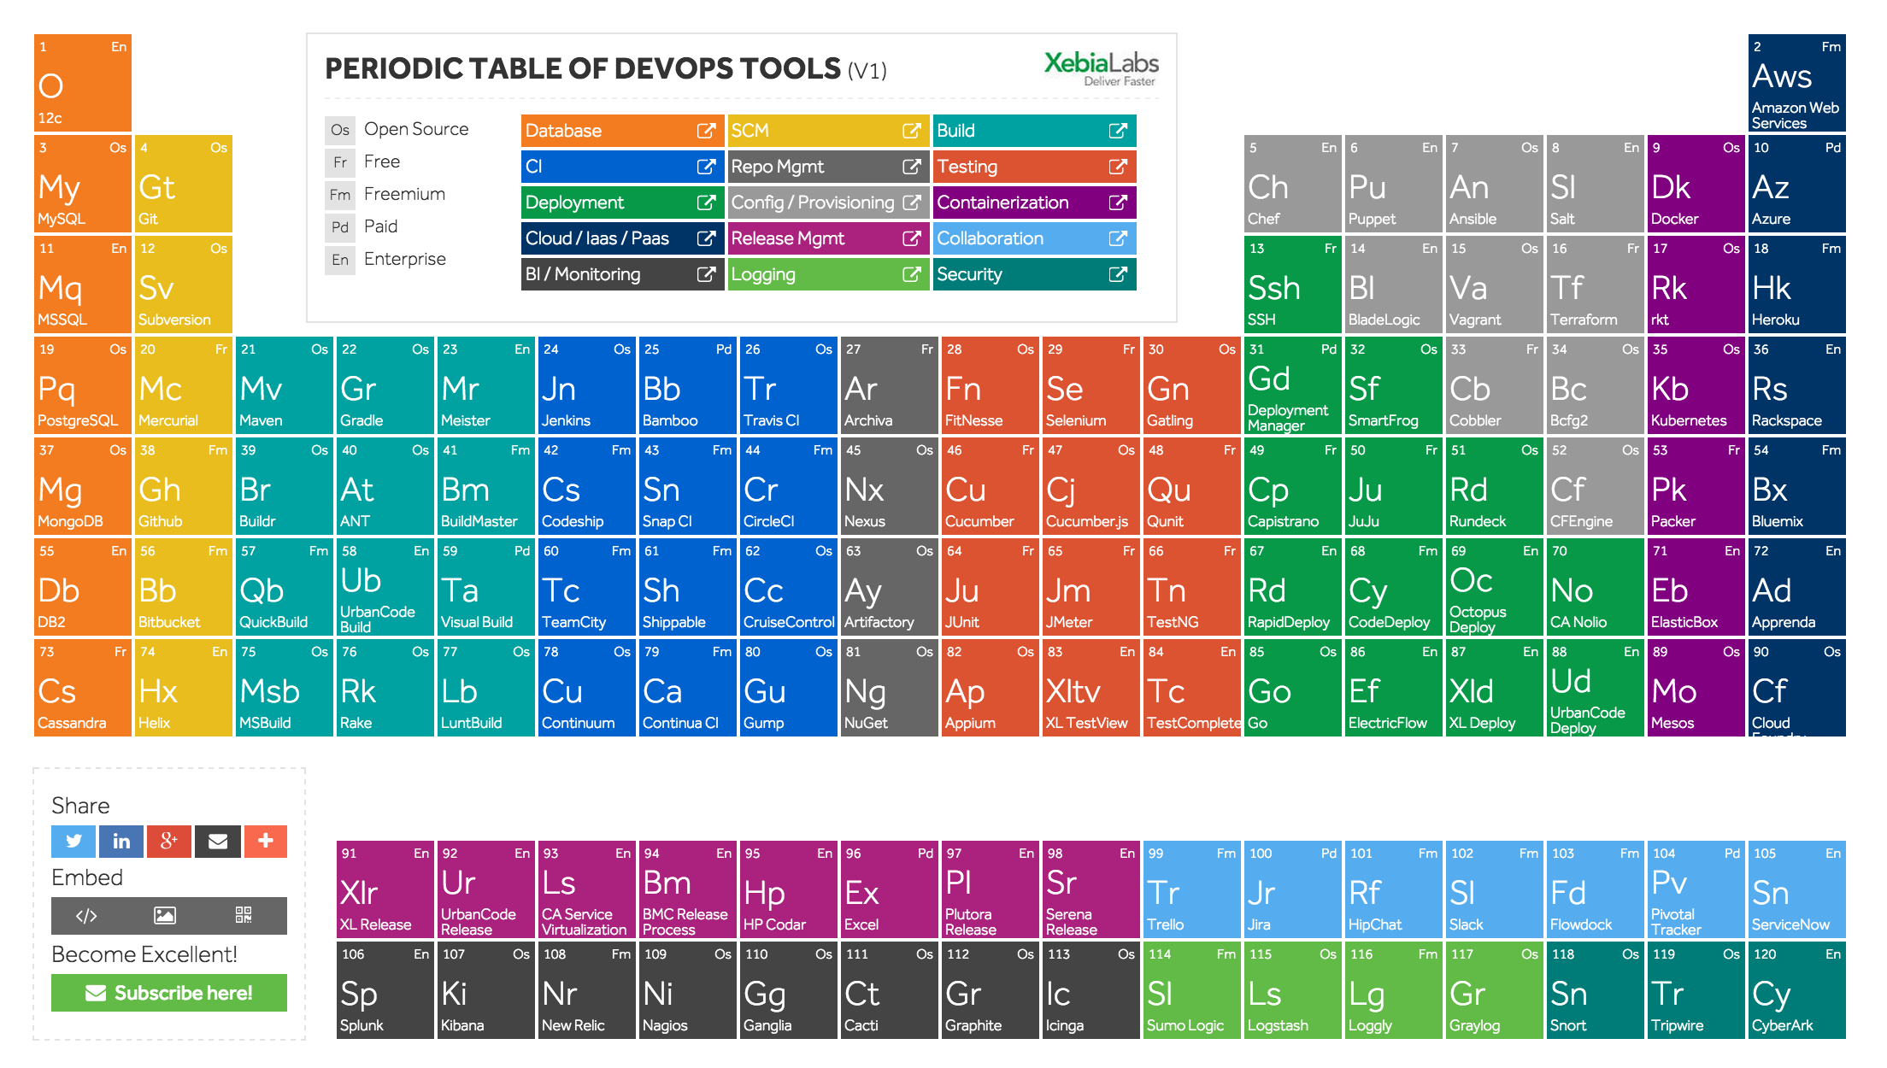
Azure
SQL
DSC
VSO
VSO
VSO
VSO
VSO
VSO
VS Release Management
SPS
Skype
Azure
Azure
Azure
AD
Notes:
This slide is just to show what we have to offer in the DevOps space. Microsoft is uniquely positioned as the only vendor to have everything you need to build a DevOps Pipeline.

